Slide 1
Relational Databases

Slide 2
Lecture Outline
Understanding the importance of data
Data Storage
Relational Databases – how they work
Categories of SQL Statements
Anatomy of SQL Query
Selection and Projection
NULL and Alias

Slide 3

Importance of Data
What do these companies have in common ??

Slide 4
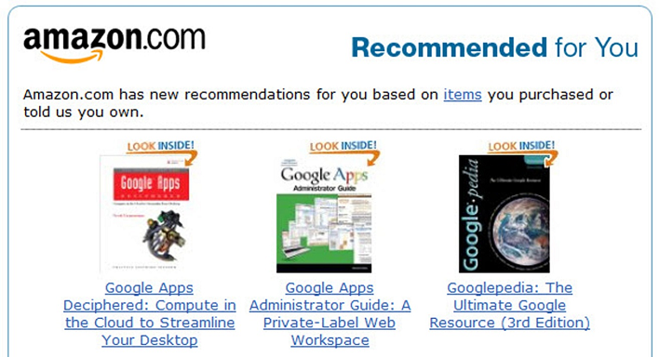
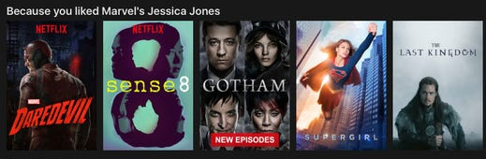
Importance of Data
Data is a foundational component behind any IT architecture.
Visualize how Facebook would work without data being captured, stored, etc..
Successful organizations are ones that take data and turn into value.
Data Science, Machine Learning, Artificial Intelligence all require tremendous data volumes to predict, match, recommend, etc.

Slide 5
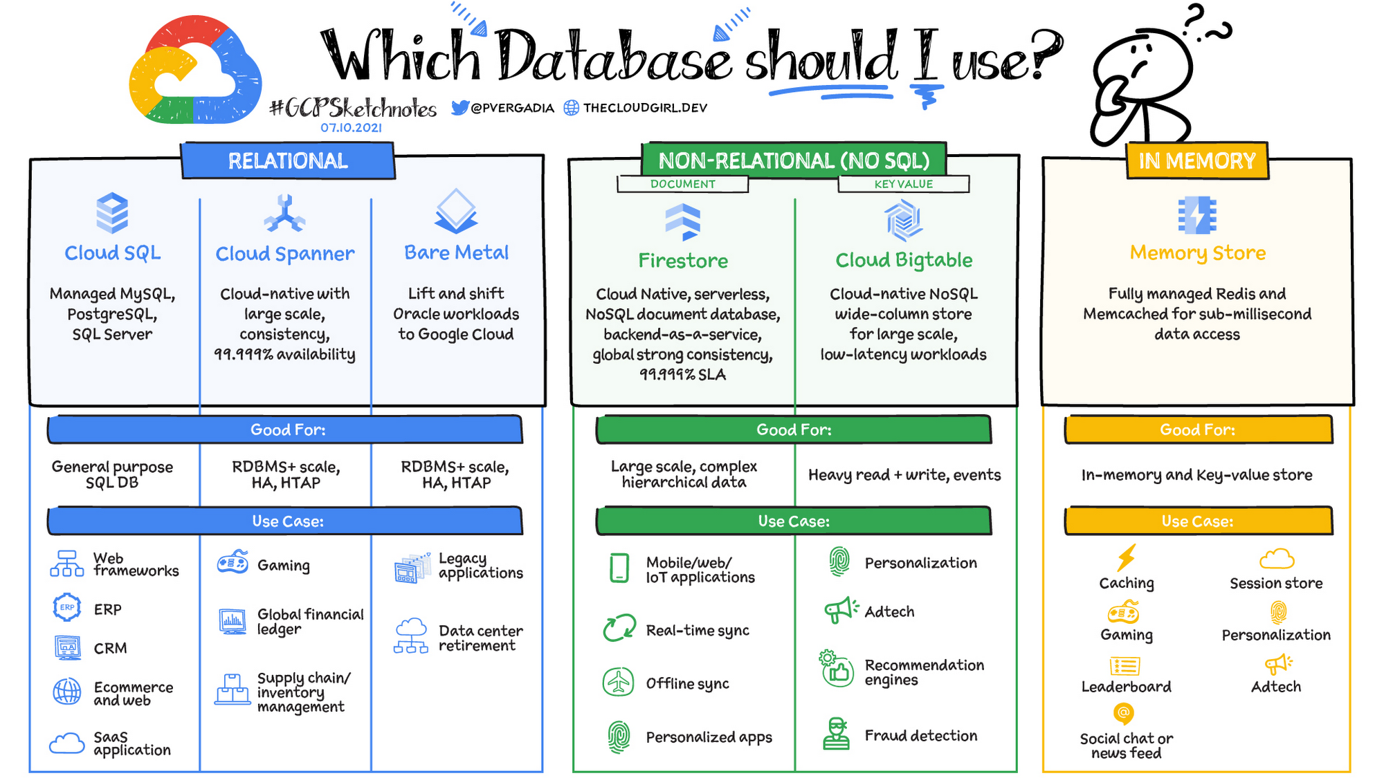
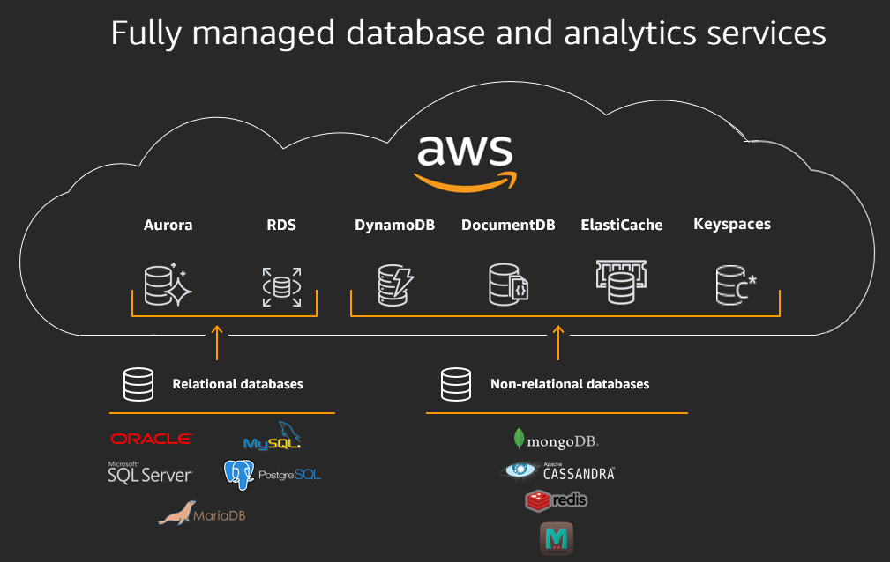
Data Storage
Several different options to store data!
Relational Database
Data Warehouse
NoSQL
Data Lake (Hadoop)
Raw files, Cloud (Object Store)
Etc.
Notes:
Images sourced from:
https://d1.awsstatic.com/AWS%20Databases/why-move-to-managed-2.65a83fae03ca12d051d2eba03eb4e45317f8f34b.png
https://storage.googleapis.com/gweb-cloudblog-publish/images/DB_header.max-2200x2200.png

Slide 6
Relational Databases
Our focus will be on relational databases for this course, with specific focus on Oracle database and syntax.
A relational database is a collection of data items with pre-defined relationships between them.
These items are organized as a set of tables with columns and rows
Tables can have hundred, thousands and sometimes even million rows of data; rows are often called records or tuples.
Tables can also have many columns of data. Columns are labeled with a descriptive name and have a specific data type
ID | F_NAME | L_NAME | Age | SIN | Salary | Bonus
1 | Paul | Singh | 34 | 123 323 232 | $2,100,000 | $150,000
2 | Doug | Jones | 15 | 654 454 541 | $15,000 | $500
3 | Mary | Smith | 30 | 844 457 512 | $89,000 | $5000
4 | … | … | … | … | … | …

Slide 7
Relational Databases
To understand how important databases have become in today's world, consider the following statistics:
Currently 20% of the world's data resides in RDBMSs.
In the next two years, databases are expected to grow larger than 100 terabytes.
A database this big would be able to store 100,000 copies of the Encyclopedia Britannica or 200,000 hours of music or about 10 billion web pages.

Slide 8
Accessing Data in an RDBMS
A relational database-management system (RDBMS) organizes data into related rows and columns.
To access the data in a database, you do not need to know where the data is located physically, nor do you need to specify an access route to the tables.
You simply use structured query language (SQL) statements and operators.

Slide 9
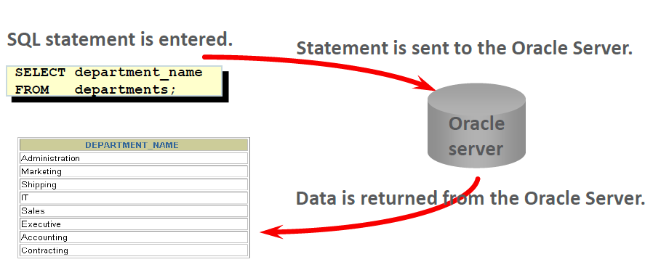
Communicating with Databases
As shown in the diagram, communicating with an RDBMS is accomplished by entering a SQL statement in Oracle Application Express.
The request is then sent to the Oracle Server (a database running on a computer), the request is processed and the data returned is displayed.

Slide 10
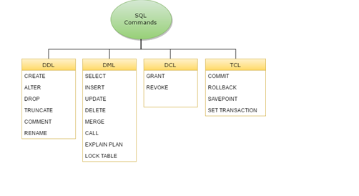
Categories of SQL Statements
DML (Data Manipulation Language) - Used to modify the table data by entering new rows, changing existing rows, or removing existing rows.
DDL (Data Definition Langauge) – DDL statements create, change, and remove data structures from the database.
TCL (Transaction Control Language) - TCL statements are used to manage the changes made by DML statements.
DCL (Data Control Language) – used to give or remove access rights to the database and the structures within it.

Slide 11
What is SQL?
Structured Query Language is a programming language used to communicate with data stored in a relational database.
SQL syntax is very similar to English language, which makes it relatively easy to write, read and interpret.
These are the most common type of SQL commands:
SELECT – extracts data
UPDATE – updates data
DELETE – deletes data
INSERT INTO – inserts new data

Slide 12
Select Statement
The SELECT statement is one of the most important keywords in SQL.
Provides you with the capability to retrieve information from the database.
Imagine that you have a MOVIE database which contains data for all possible movies, actors, producers, regions.
The select statement allows for searching for:
All movies ever created.
All movies starring Keanu Reeves.
All movies starring Keanu Reeves in 2004.

Slide 13
Examining the SELECT statement
The most simplest form of a SELECT statement
SELECT <column(s)> FROM <table>
Columns: specifies which column of data you want to return.
Table: specifies the table containing the columns list in the SELECT statement.

Slide 14
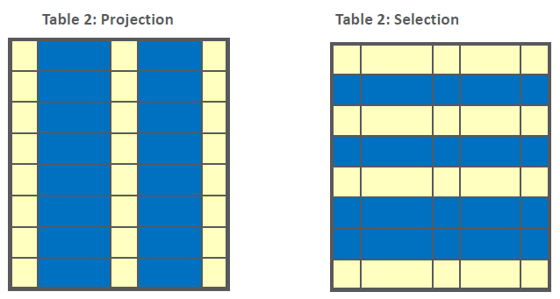
Capabilities of SELECT statements
Projection: Used to choose columns in a table
Selection: Used to choose rows in a table

Slide 15
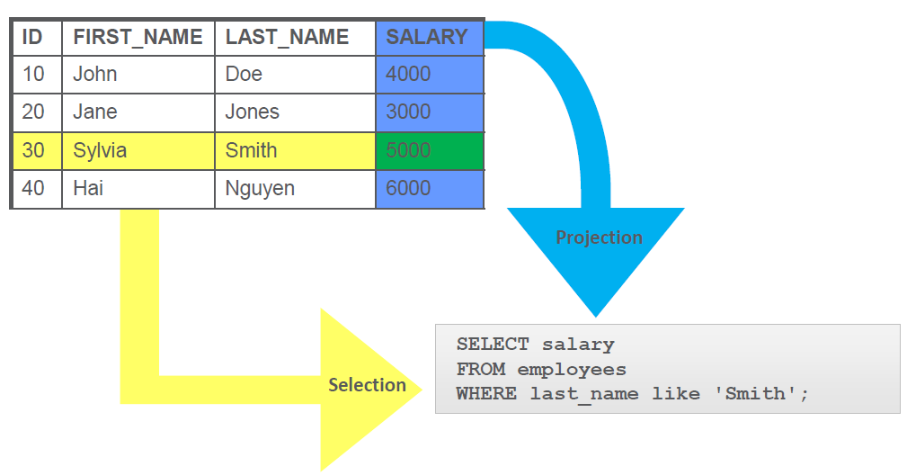
Projection and Selection

Slide 16
Selecting All Columns
You can display all of the columns of data in a table by using an asterisk symbol (*) instead of a column name in the SELECT clause.
In the example shown, all of the columns in the countries table are selected.
SELECT * FROM countries;
COUNTRY_ID | COUNTRY_NAME | REGION_ID
CA | Canada | 2
DE | Germany | 1
UK | United Kingdom | 1
US | United States of America | 2

Slide 17
Selecting All Columns
You can also display all the columns in a table by listing them individually.
SELECT country_id, country_name, region_id
FROM countries;
COUNTRY_ID | COUNTRY_NAME | REGION_ID
CA | Canada | 2
DE | Germany | 1
UK | United Kingdom | 1
US | United States of America | 2

Slide 18
Projecting Specific Columns
If you want to PROJECT only specific columns from a table to be displayed, simply list each of the column names you want and separate each name with a comma in the SELECT clause.
SELECT location_id, city, state_province
FROM locations;
LOCATION_ID | CITY | STATE_PROVINCE
1800 | Toronto | Ontario
2500 | Oxford | Oxford
1400 | Southlake | Texas
1500 | Seattle | Washington

Slide 19
Using Arithmetic Operators
Using a few simple rules and guidelines, you can construct SQL statements that are both easy to read and easy to edit.
Knowing the rules will make learning SQL easy.
You may need to modify the way in which data is displayed, perform calculations, or look at what-if scenarios.
For example, "What if every employee was given a 5% raise?
How would that affect our yearly profit figures?"

Slide 20
Using Arithmetic Operators
These types of calculations are all possible using arithmetic expressions.
You are already familiar with arithmetic expressions in mathematics:
add (+), subtract (-) , multiply (*) and divide (/)
Note that this example does not create new columns in the tables or change the actual data values.
The results of the calculations will appear only in the output.

Slide 21
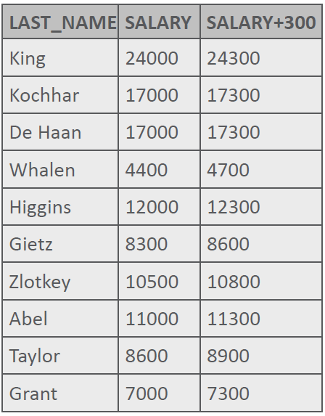
Using Arithmetic Operators
The example shown uses the addition operator to calculate a salary increase of 300 for all employees and displays a new SALARY + 300 column in the output.
Putting in blank spaces before and after an arithmetic operator will not affect the output.
SELECT last_name, salary, salary + 300
FROM employees;

Slide 22
NULL Values
In SQL, NULL is an interesting word.
To understand NULL, you have to know what NULL is and what NULL is not.
NULL is a value that is unavailable, unassigned, unknown, or inapplicable.
NULL is not the same as a zero or a space.
In SQL, a zero is a number, and a space is a character.

Slide 23
NULL Values
Sometimes, you don't know the value for a column.
In a database, you can store unknowns in your databases.
Relational databases use a placeholder called NULL or null to represent these unknown values.

Slide 24
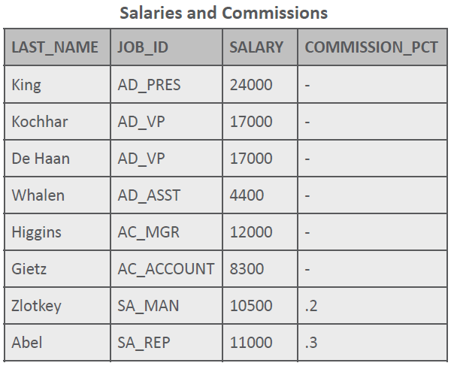
NULL Values
If any column value in an arithmetic expression is null, the result is null or unknown.
If you try to divide by null, the result is null or unknown.
However, if you try to divide by zero, you get an error.

Slide 25
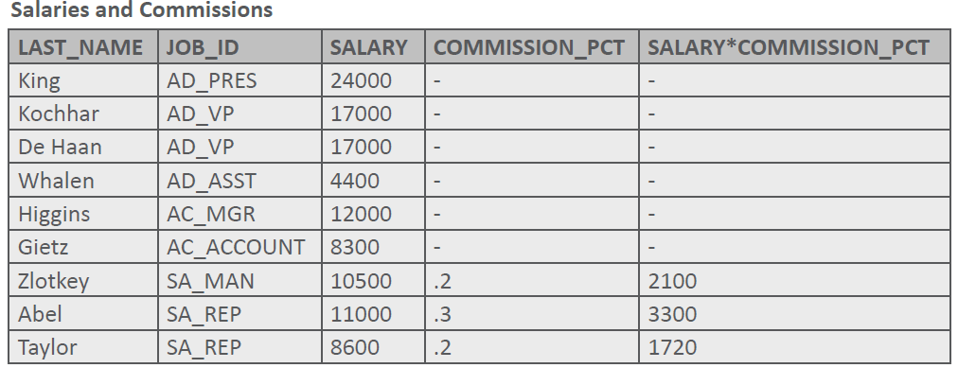
NULL Values
SELECT last_name, job_id, salary, commission_pct, salary*commission_pct
FROM employees;

Slide 26
Alias
An Alias is a way of renaming a column heading in the output.
Without aliases, when the result of a SQL statement is displayed, the name of the columns displayed will be the same as the column names in the table or a name showing an arithmetic operation such as 12*(SALARY + 100).
You probably want your output to display a name that is easier to understand, a more "friendly" name.
Column aliases let you rename columns in the output.

Slide 27
Alias
There are several rules when using column aliases to format output.
A column alias:
Renames a column heading
Is useful with calculations
Immediately follows the column name
May have the optional AS keyword between the column name and alias
Requires double quotation marks if the alias contains spaces or special characters, or is case-sensitive

Slide 28
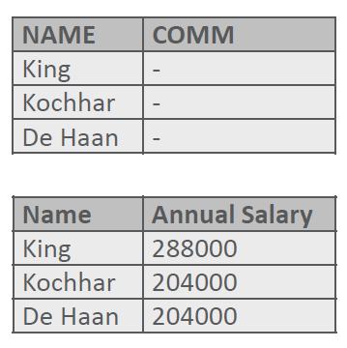
Using Column Aliases
The syntax for aliases is:
Examples:
SELECT * |column|expr[ AS alias], .....
FROM table;
SELECT last_name AS name,
commission_pct AS comm
FROM employees;
SELECT last_name "Name",
salary*12 "Annual Salary"
FROM employees;

